Slide 1
IN4331 Web Data Management Assignment outcomes
Ioana Jivet (4259610)
Nidhi Singh (4242246)

Slide 2
Assignment 1 Tree Pattern Evaluation
Notes:
No documentation: user- and developer-wise. We shaped our aim over the quarter: to provide documentation for developers. Whenever contributors want to get involved with the project, they have a starting point.
Project quality: After patching and patching the system, the quality of the system will be affected =>
Coding standards: As it is an open source project, with lots of contributors, the code has a lot of styles. They somewhat adopted some coding conventions, but they don’t seem that strict.
Maintenance: Easier for the core-team to identify what changes a contributor did: via pull requests: if the classes changed are the right ones, if they affect the architecture of the system

Slide 3
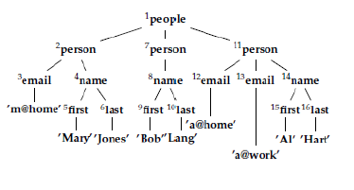

Tree pattern evaluation
Purpose: obtain query results from XML files

Slide 4
Tree pattern evaluation
Purpose: obtain query results from XML files

Slide 5
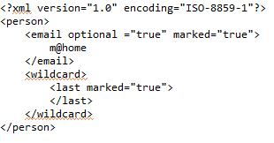
Input
Two XML files
Support for tree patterns: marked nodes, optional nodes, wildcards and value predicates

Slide 6
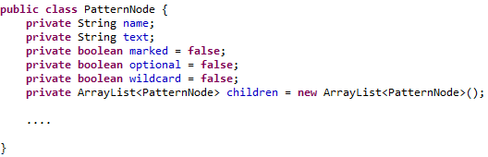
Query representation
Tree pattern SAX parser

Slide 7
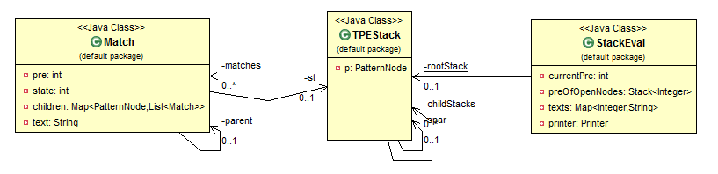
The evaluation algorithm

Slide 8
The evaluation algorithm
Implemented using a SAX parser
startDocument(), endDocument()
startElement(), endElement(), characters()
Tags are manipulated through a stack
Checks for valid matches
Ancestor relations

Slide 9
Match extraction
After the run, the results are stored in the root TPEStack
Results are extracted recursively, in a depth-first manner

Slide 10
Extensions Wildcards
Create a Match for every opening tag encountered
Checks are done only on descendants
Optional nodes
Validate matches in the endElement() method

Slide 11
Extensions Value predicates
Texts are saved in a map and checked against the value predicate stored in the pattern node

Slide 12
Assignment 2 Large-Scale Data Management with HADOOP
Notes:
No documentation: user- and developer-wise. We shaped our aim over the quarter: to provide documentation for developers. Whenever contributors want to get involved with the project, they have a starting point.
Project quality: After patching and patching the system, the quality of the system will be affected =>
Coding standards: As it is an open source project, with lots of contributors, the code has a lot of styles. They somewhat adopted some coding conventions, but they don’t seem that strict.
Maintenance: Easier for the core-team to identify what changes a contributor did: via pull requests: if the classes changed are the right ones, if they affect the architecture of the system

Slide 13
MapReduce jobs

Slide 14
Combiner functions Exercise 1

Slide 15
XML processing with HADOOP Exercise 2

Slide 16
PIGLATIN scripts Exercise 3

Slide 17
Inverted file project Exercise 4

Slide 18
IN4331 Web Data Management Assignment outcomes
Ioana Jivet (4259610)
Nidhi Singh (4242246)

